Slide 1
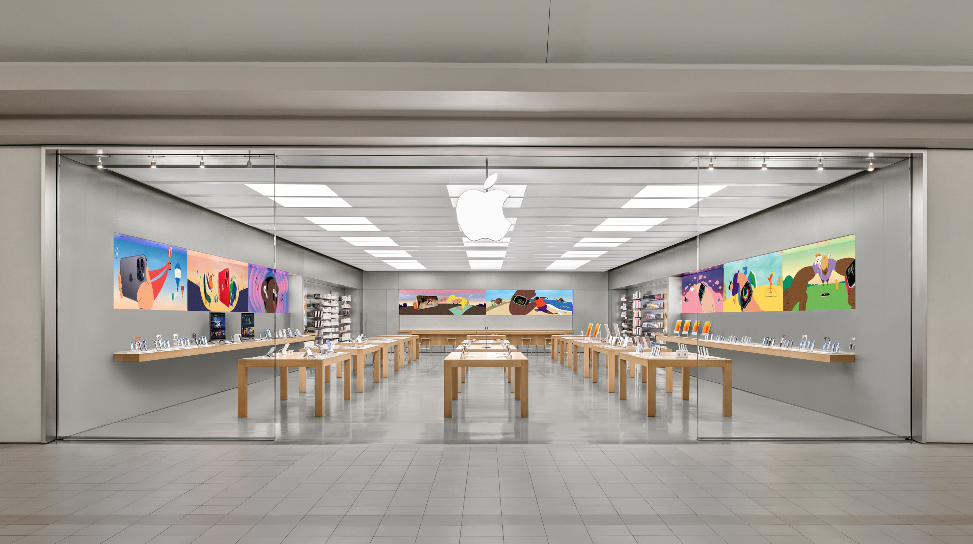
Feature Extraction and Price Prediction-Cell Phones
Title- Price Prediction With ML Models
Name-Debasis Panda
GitHub- https://github.com/Deb052024/Machine-Prediction.git

Slide 2
Feature Extraction and Model Building-Case Flow
Project Scenario and Objective
EDA Based Features Observation - 1 ,2
Cell Phone Feature and Insights
Pair Plot and Skewness Interpretation
Highest Price Models Key Features Comparison
Feature Importance and Selection
Supervised Machine Learning Model Building and Performance Based on KPI
Cross Validations
Recommendation and Conclusion

Slide 3
Project Scenario and Objective
Project Scenario:
The organization is keen to enhance its pricing strategy by gaining a deeper understanding of the key features that influence the prices of mobile phones.
Objective: To build a predictive model that can accurately estimate the price of a mobile phone based on its features.

Slide 4
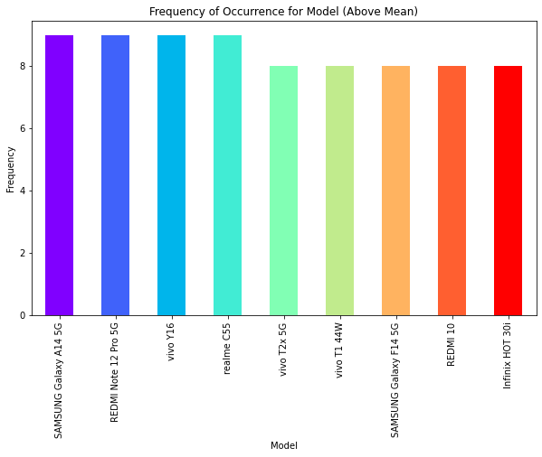
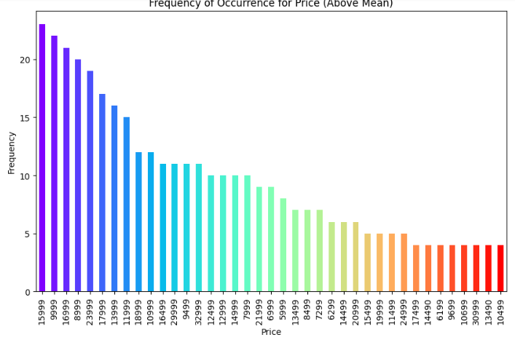
EDA Based Observations Across Models-1
Interpretation:
SAMSUNG Galaxy A145G, REDMI Note 12Pro 5G, VIVO Y16, realmeC55 have got maximum occurrences
Interpretation :
Top 3 prevalence of Price in market are 15999,9999 & 16999
10499 is having least least occurance in market

Slide 5
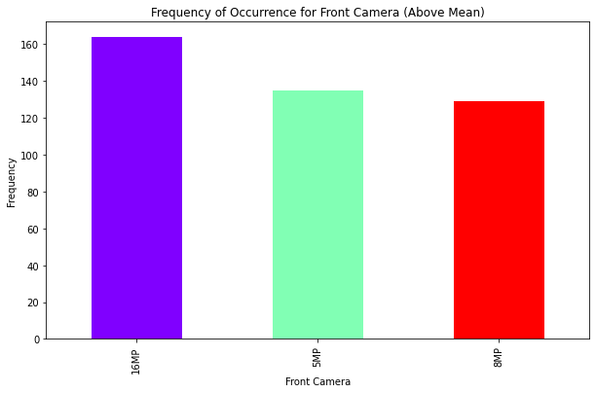
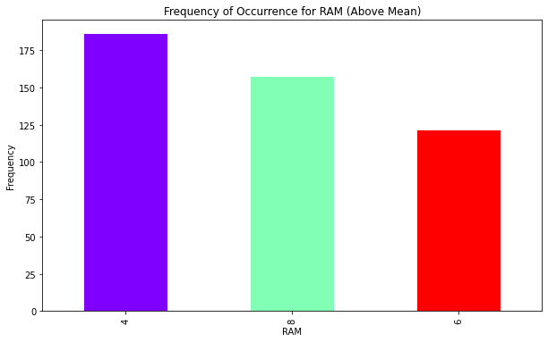
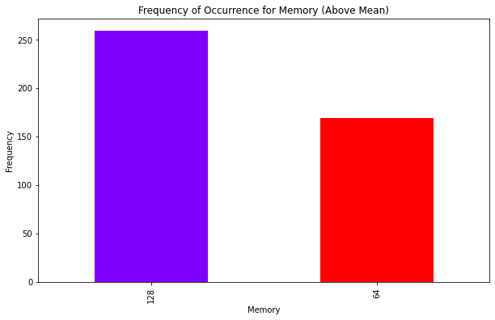
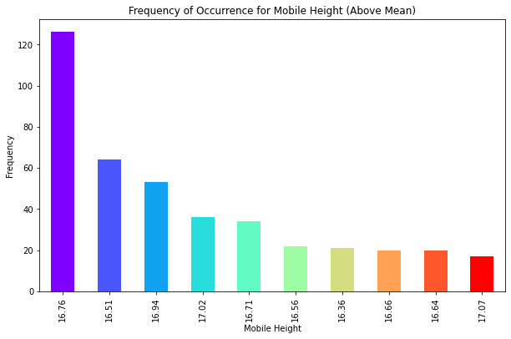
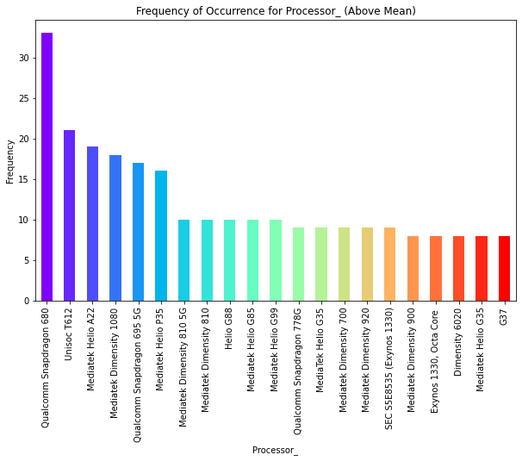
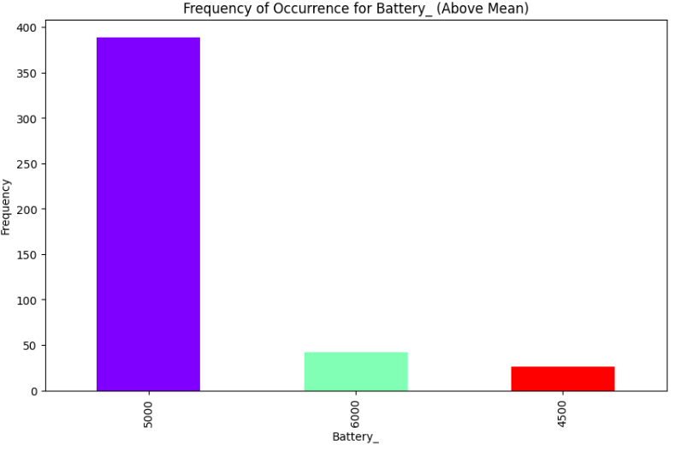
EDA Based Observations Across Models-2
Fig-1,2,3-Features- Maximum cell phones with 126GB Memory, 4 GB RAM and 16MP Front camera
Fig-1
Fig-2
Fig-3
Fig-1: 16.76 inch height handset are having maximum presence in the distribution
Fig-2: Qual Comm Snap Dragon Processors are mostly used in cell Phones
Fig-3: 5000mH battery is mostly present across cell phones

Slide 6
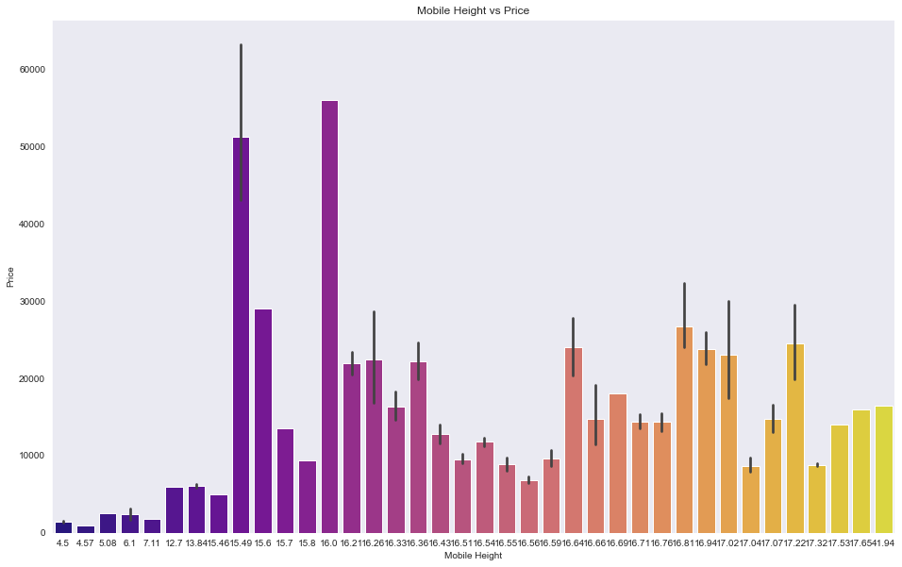
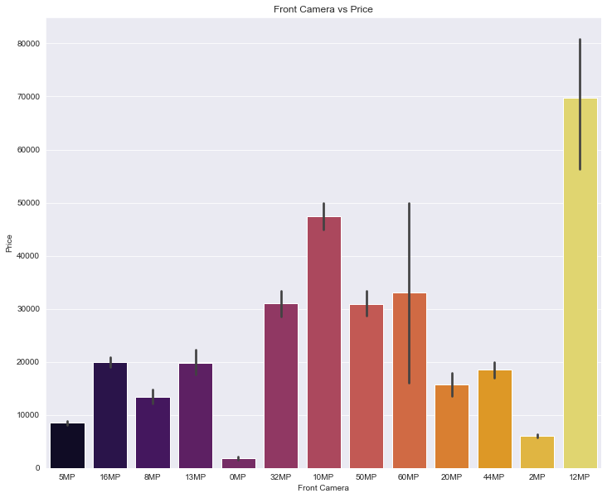
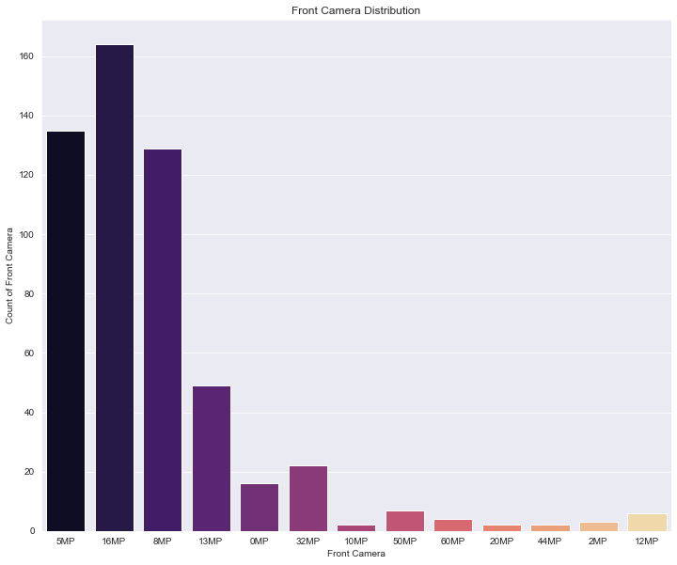
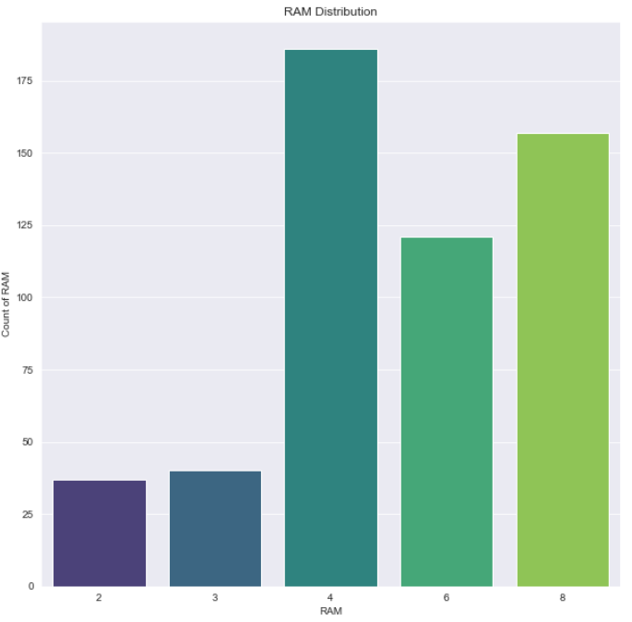
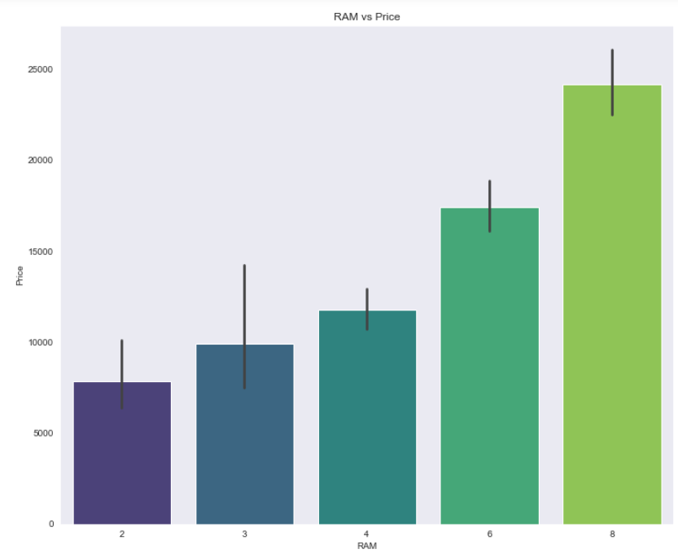
Cell Phone Features and Insights
Fig-3
Fig-1:Maximum cell phones with 16inch height
Fig-2 &3: 12 MegaPixel Front camera are costliest for Apple and Samsung but most cameras present are of 10 or 8 Mega Pixel,
8GM RAM is the most sought after for Samsung - how ever the current distribution is having most cell phones with 4GB RAM

Slide 7
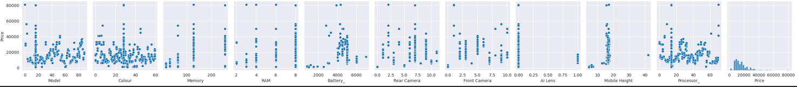
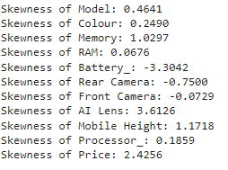
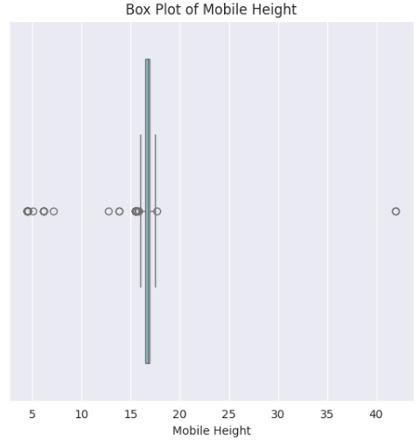
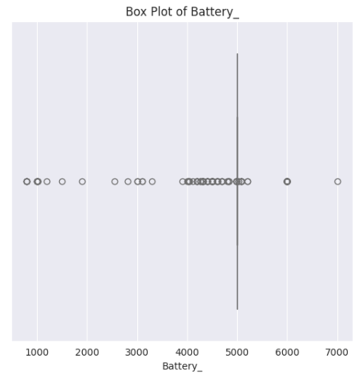
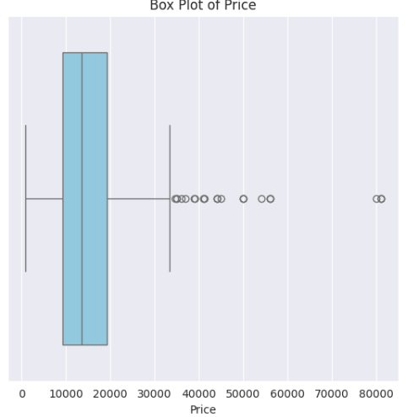
Pair Plot and Skewness Interpretation
Pair Plot Interpretation-
a. Price has got positive relation with features like Mobile Height
b. Very few AI lens with 1.0 MegaPixel , almost data has got 0 Mega Pixel AI lens
c. 8 GB Ram has got maximum presence across cell phones and has got maximum price point
Skewness Interpretation :
Maximum positive symmetricity of data for features like Price, Mobile Height and Negative for Battery
Mobile Height- From 20MM to 40MM there exists hardly any cell phone in market
Skewness reflects the presence of outliers for the Features across Data Set

Slide 8
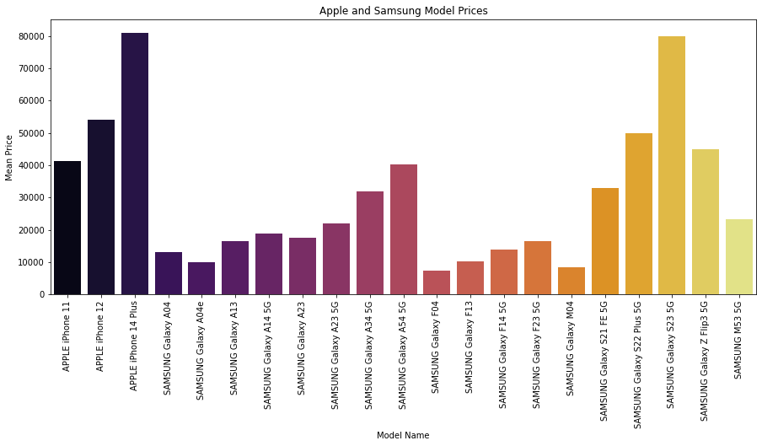
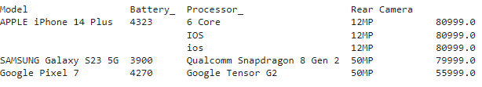
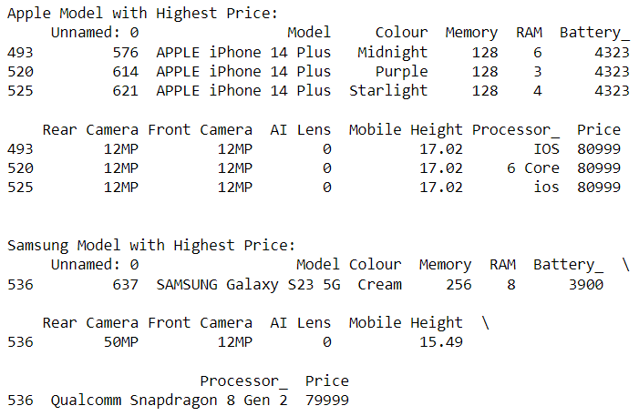
Highest Price Models- Key Feature Comparison
Top three brands with highest selling prices are Apple iPhone 14 Plus, Samsung Galaxy S23 5G and Google Pixel 7
Three highest price models within Apple brand are Apple iPhone 14Plus, Apple iPhone12 and Apple iPhone11
Apple Phones are most costliest in market with equal front and Rear camera of 12 Mega Pixel
Three Highest price models within Samsung Brand are Samsung Galaxy S23 5G, Samsung Galaxy S22 Plus 5G, Samsung Galaxy Z Flip 5G
Mid Night, Purple and Straight are three key colors of Apple I Phone 14 Plus with 4323Mh Battery each
Samsung costliest phones are shorter by 2mm in Height compared to Apple

Slide 9
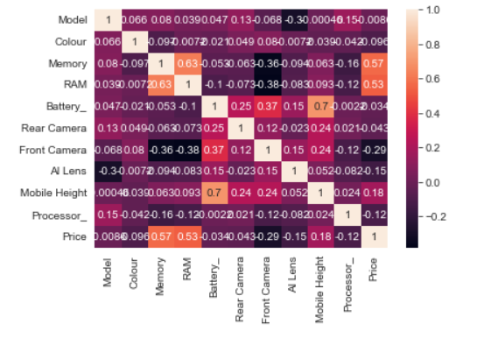
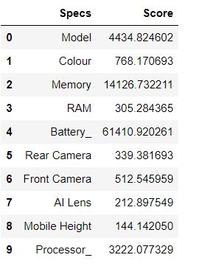
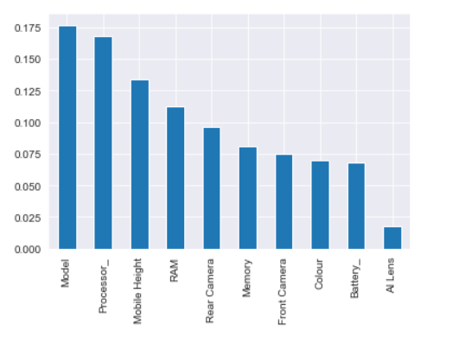
Feature Importance and Selection
Based on High Degree of positive correlation – Key Features related to price are –Memory, RAM, Mobile Height
Based on SelectKBest –Key Features are – Model, Battery, Memory, Processor
Based on ExtraTree Classifier –Key Features are – Model, Battery, Mobile Height ,Processor

Slide 10
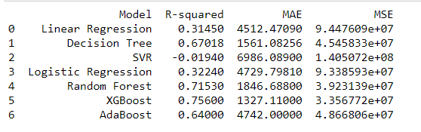
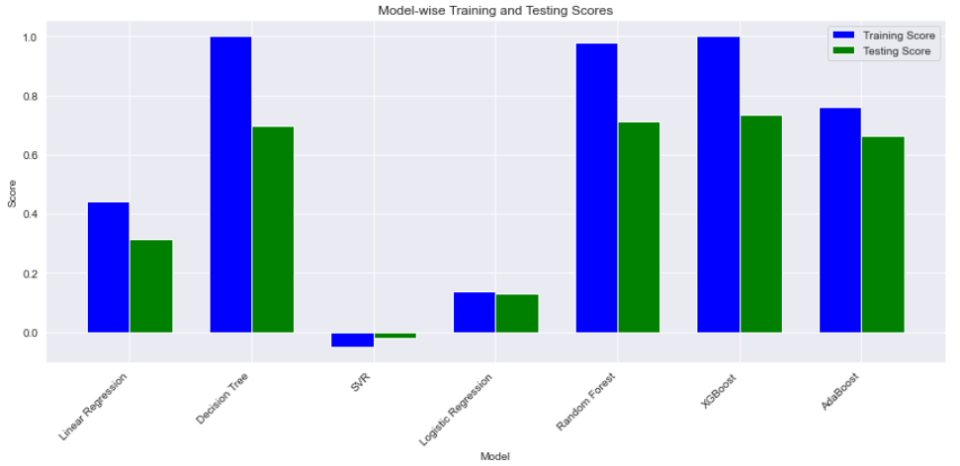
Supervised Regression Machine Learning Models and KPI
 | Scores
Model Name | Training Accuracy | Testing Accuracy
Linear Regression | 0.44 | 0.31
Decision Tree Regressor | 0.99 | 0.69
Support Vector Regressor | -0.05 | -0.019
Logistics Regression | 0.13 | 0.12
Random Forest Regressor | 0.97 | 0.71
XGB Regressor | 0.99 | 0.74
AdaBoost Regressor | 0.76 | 0.66
Logistics Regression Training and Testing score are least
XGBoost and Random Forest Regressor scores are highest and scond highest
R^2 , Mean Absolute Error and Mean Square values indicate XGBoost is the best predictor model for Price, but its bit over fit
The difference between train and test accuracy score is least for AdaBoost , hence is a best fit model, neither over fit or under fit
Adjacent graph depicts ensemble techniques perform well compared to individual learner models

Slide 11
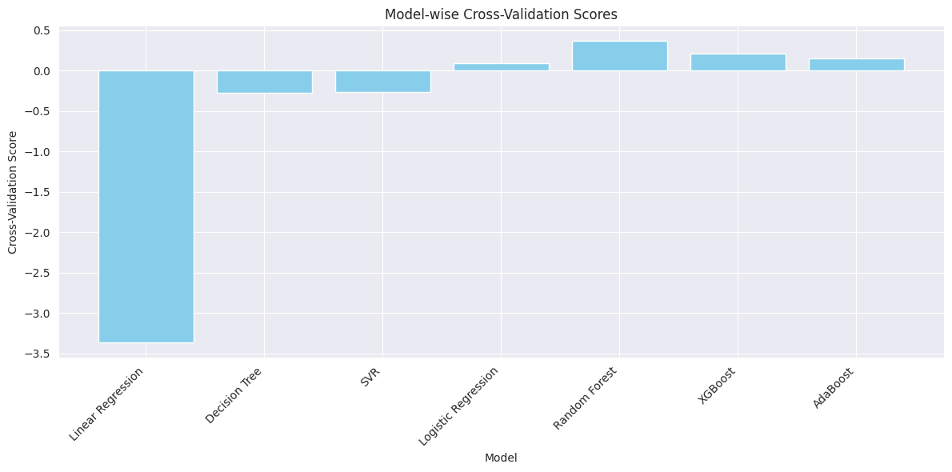
Cross Validation Comparison
Based on Cross Validation R*2 scores across models were plotted
Regression Model R*2 scores are lowest
More spread on validations on higher side for Random Forest, XGBoost and AdaBoost

Slide 12
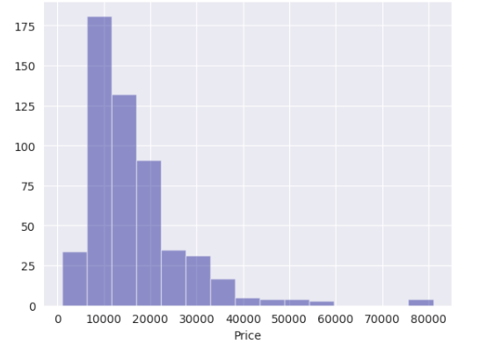
Recommendations and Conclusion
Top three brands with highest selling prices are Apple iPhone 14 Plus, Samsung Galaxy S23 5G and Google Pixel 7
With 128GB Memory APPLE are the costliest with bigger heights compared to 256GB Memory of Samsung Cell Phones, Brand being the differentiator
12MegaPixel Front camera are costliest for Apple and Samsung but most cameras present are of 10 or 8 Mega Pixel,
8GM RAM is the most sought after for Samsung - how ever the current distribution is having most cell phones with 4GB RAM
Ensemble Techniques perform better in Model Accuracy than normal learning models
XGBoost is having highest accuracy but bit overfit how ever AdaBoost is neither over fit nor under fit in price predictions
R*2 square with least MAE(Mean Absolute Error ) is present for XGBoost
Premium and Discount on Price strategies for Premium(Apple, Samsung ) and Non Premium Brands respectively
Fig-1- Price Histogram Plot-
Interpretation-
Reflects maximum cell phones with 10k to 40k Range
No cell Phone on 70k Price bracket, there is a scope for brands to pitch in at the price point

